Slide 1
Digital Security and Forensics AICT006-4-2-DSF Version 2
Social Engineering, Physical & Password Attacks

Slide 2
Topic & Structure
Nontechnical Password Attacks
Technical Password Attacks
Password Cracking Techniques
Social Engineering Basics
Use of Social Engineering in Penetration Testing
Tools and Techniques

Slide 3
Learning Outcomes
At the end of this topic, You should be able to:
Identify different types of nontechnical password attacks
Identify different types of technical password attacks
Review several methods of password cracking.
Explain the human errors as a factor in system hacking
Social engineering concepts and impact on security
Identify the common techniques to gain human trust.

Slide 4
Key Terms You Must Be Able To Use
If you have mastered this topic, you should be able to use the following terms correctly in your assignments and exams:
Password Attack
Online/Offline password attack
Bypass Authentication
Social Engineering Attacks
SET tools kit

Slide 5
Social Engineering

Slide 6
Social Engineering
Any act that influences a person to take any action that may or may not be in their best interest.

Slide 7
Social Engineering: Security Context
Social engineering is the use of influence and persuasion to deceive people for the purpose of obtaining information or to perform some action.
Obtain confidential information (passwords)
Obtain personal information

Slide 8
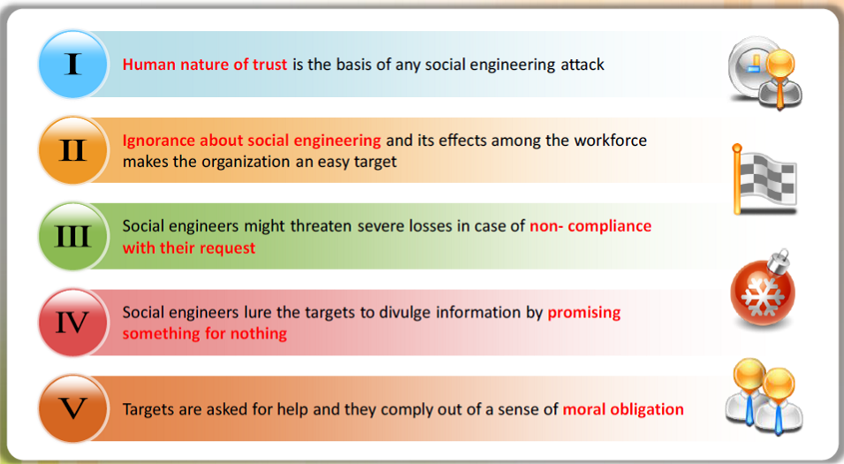
Vulnerable Behaviours

Slide 9
Social Engineering Types
Pretexting
Tailgating
Vishing
Baiting
Quid Pro Quo
Phishing
Water Holing

Slide 10
Pretexting
Cyber Security Awareness Committee
Using a fictitious scenario (i.e. the pretext) the criminal establishes trust—perhaps through impersonation—which is leveraged to create a false motive for an unsuspecting individual to divulge information or do something he or she normally would not do.

Slide 11
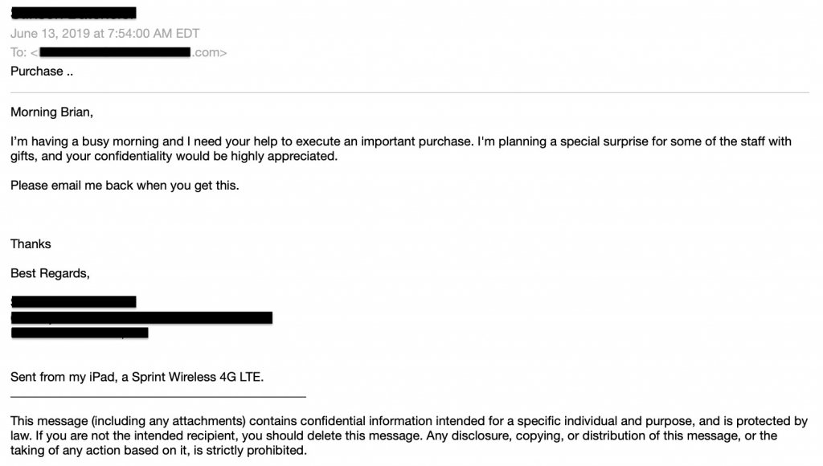
Pretexting

Slide 12
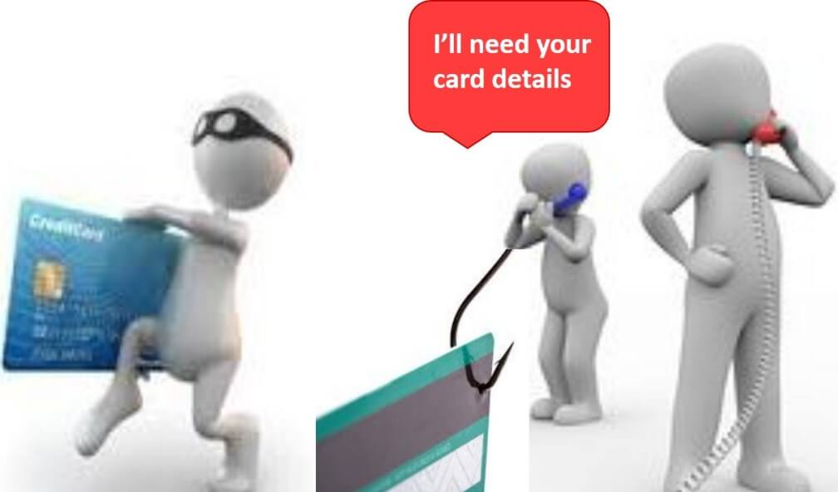
Vishing
Making phone calls or leaving voice messages purporting to be from reputable companies in order to induce individuals to reveal personal information or do something they would not normally do.

Slide 13
Another Kind of Vishing
Some criminals prompt targets to phone a number they claim is from a trusted institution to verify their personal information.
The mark calls in and provides their private information to an Interactive Voice Response system.

Slide 14
Social Engineering: Quid Pro Quo – Something for Something
The attacker calls extensions at a company claiming to follow up on a technical problem.
Eventually finds someone with an issue.
In the course of providing tech support, the end user provides system access or types in a malicious command.

Slide 15

Social Engineering: Water Holing
The attacker finds a weakness in a legitimate website known for attracting a target group.
Using the compromised site, visitor systems are infected with malware because people trust the site owners.

Slide 16

Social Engineering: Tailgating
The attacker seeks access to a restricted area.
Simply walks in behind a person with legitimate access.

Slide 17
Baiting
Attackers leave malware-infected DVDs or USB flash drives in locations people will find them, giving them names that pique people’s curiosity.
An employee looking out of curiosity or to determine how to return it puts it in his or her system and gets infected.

Slide 18
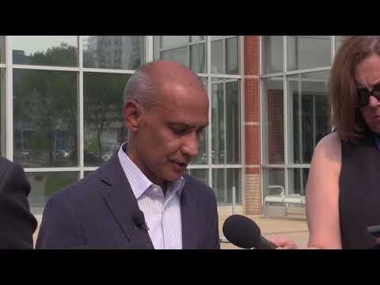
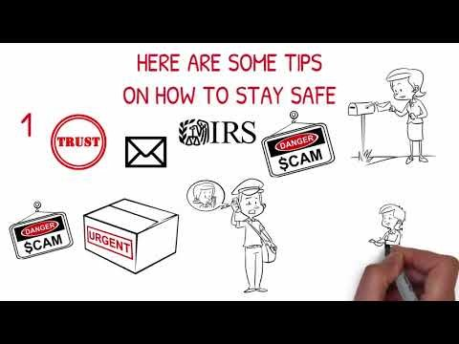
What is Phishing?
Phishing is the attempt to obtain sensitive information such as usernames, passwords, and credit card details…by disguising as a trustworthy entity in an electronic communication.
Phishing is typically carried out by email spoofing…and it often directs users to enter personal information at a fake website, the look and feel of which are identical to the legitimate one.

Slide 19
Other Types of Social Engineering
And there’s much, much more….
Spam email – Irrelevant, unwanted, and unsolicited email to collect the financial information social security numbers and network information.
Instant Chat Messenger – Gathering personal information by chatting with a selected online user to get information such as birth dates and maiden names.
Chain Letters – Chain letters are emails that offer free gifts such as money and software on the condition that the user has to forward the email to the said number of persons.
Hoax Letters – Hoax letters are emails that issue warnings to the user on new viruses, Trojans, or worms that may harm the user’s system.
Pop-up Windows – Windows that suddenly pop up while surfing the Internet and ask for users’ information to login or sign-in.
Like tricking users to copy and paste malicious code into their browser’s web development console.

Slide 20
What We Can Do About It?

Slide 21
What constitutes an attack ?
Physical Aspects
In the workplace
Psychological Aspect
Persuasion
Impersonation
Friendliness
Over the phone
Trash Area
On-line Portals
Out of Office

Slide 22
Can I Identify An Attacker?
Unfortunately,
Almost anyone is potentially capable of mounting a social engineering attack
It is not easy to decipher a Social engineering attack
Characteristic Traits:
Refusal to give contact information,
Rushing,
Name-dropping,
Intimidation on questioning,
Committing Small mistakes
Requesting forbidden information

Slide 23
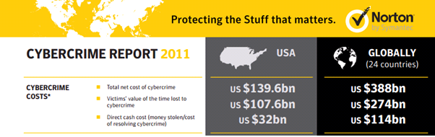
What can be the impact?
Norton / Symantec Cyber Crime Report 2011
Impact can be a loss of any of the below:
Confidential Information
Corporate Reputation & Brand
Customers

Slide 24
What do I do?
People
Process
Technology
Solution is simple and age-old
PPT
The three building blocks for any Firm
Our priorities are wrongly set
Investments to be made in the right pockets
Awareness needs to be the key tactical as well as strategic Goal

Slide 25
What do I do?
It is only as good as the people who use it and the process which defines its usage or boundaries
Will technology add value? - is no longer a question but rather a factual statement.
We need to maintain the balance between investment and requirement.
Important
People
Process
Technology
Defines what People and Technology do to make a system work
A flawed process leads to the other two components failing, though they might be the best in themselves individually
This needs to be defined at the early stages
Has a bad habit of defining itself, if not managed and defined properly
Very Important
Core building block to each and everything in an Organization,
They control processes, control technologies as well as manage other people
Any flaw in the People component will indirectly affect all the three components in the long run
It is highly important that people are trained in their respective fields to make informed decisions.
It is also important that the right people are mapped to the right systems as wrong mappings can crash the whole system.
Most Important

Slide 26
How To Defense
Scrutinize what information in the workplace is sensitive and evaluate exposure to breakdowns in security including social engineering.
Establish security protocols, policies, and procedures for handling sensitive information.
Train employees in the security protocols relevant to their position
Periodically test the systems to make sure they work.
Periodically Review your defensive posture to make sure that your systems, procedures, protocols and training are up-to-date.
Make sure that private documents are adequately handled by shredding or secure disposal.

Slide 27
Password Attacks

Slide 28
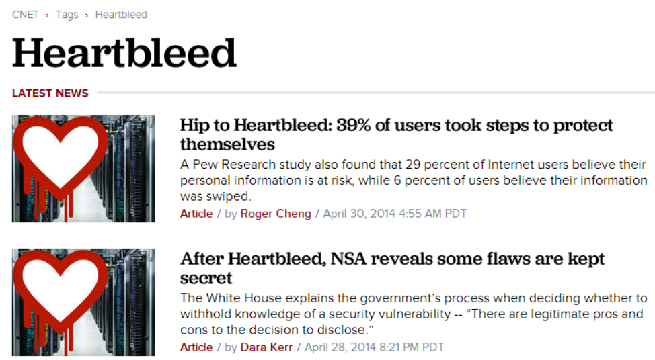
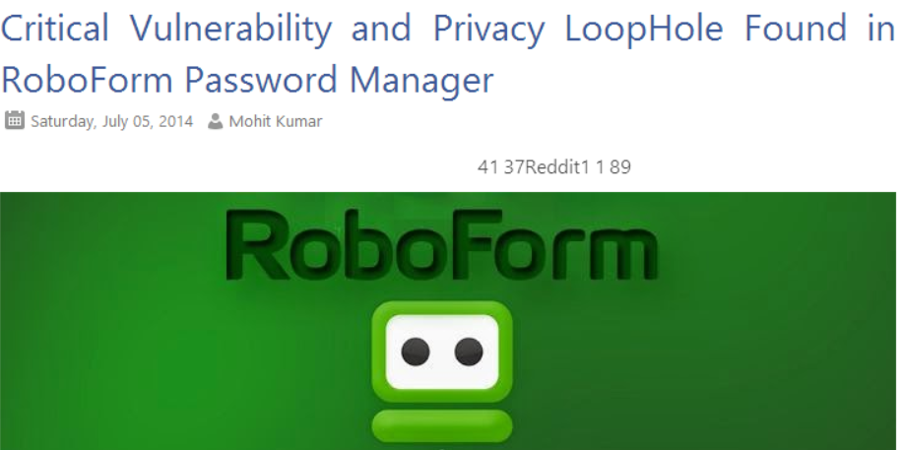
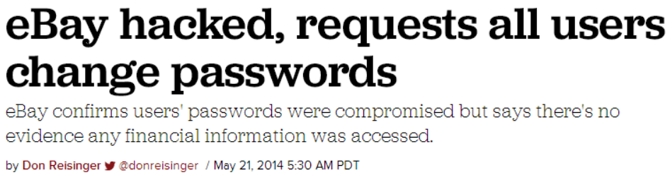
Password
A password is a word or string of characters used for user authentication to prove identity or access approval to gain access to a resource (example: an access code is a type of password), which should be kept secret from those not allowed access.

Slide 29
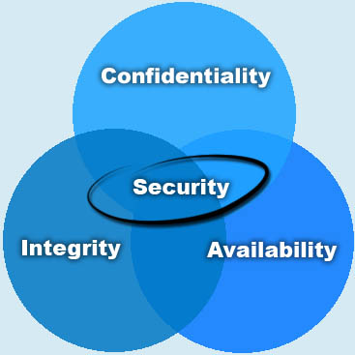
Elements of Information Security
Confidentiality: to make sure that authorized user has access to the information.
Integrity: to make sure that the information is secure from unauthorized changes.
Availability: to make sure that the system responds 24/7.
References:
http://cybermap.kaspersky.com/
http://www.digitalattackmap.com/

Slide 30
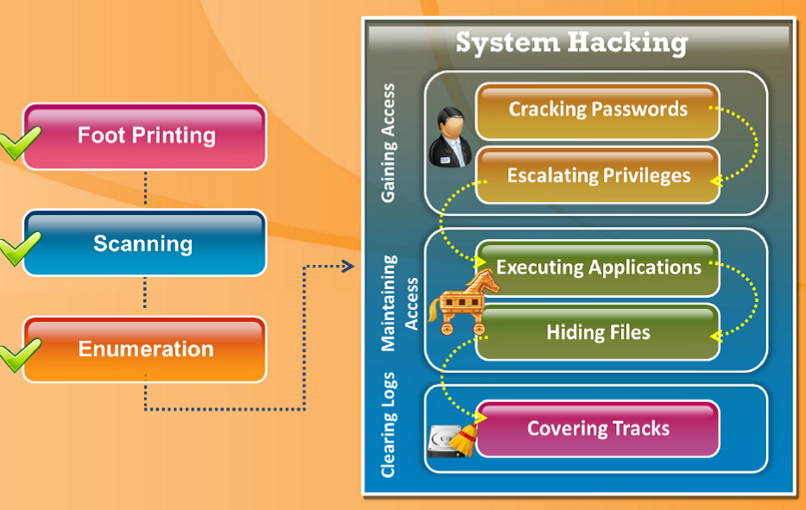
Penetration Test and Password Attack

Slide 31
Penetration Test and Password Attack
Uses it on
other systems
Attacker grabs local password on one box
Grabs passwords from other systems, and installs keyloggers/sniffers to get network credentials for more systems

Slide 32
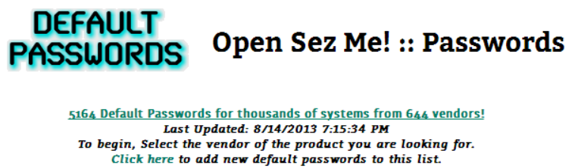
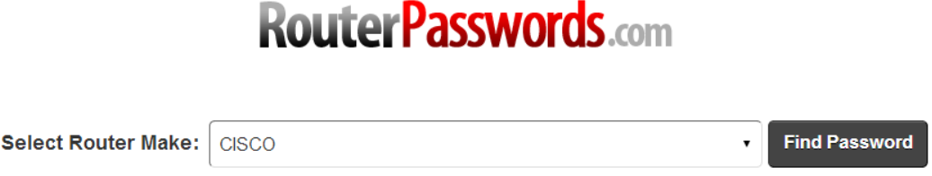
Default Password
It is very common that people do not change the default password of devices supplied by the manufacturer.
References
https://www.defaultpassword.com/
https://www.routerpasswords.com/
https://cirt.net/passwords
https://defaultpassword.us/
https://open-sez.me/passwd.htm

Slide 33
Password Complexity
Passwords must contain characters from three of the following four categories:
Uppercase characters (A through Z)
Lowercase characters (a through z)
Base 10 digits (0 through 9)
Nonalphanumeric characters: ~!@#$%^&*_-+=`|\(){}[]:;"'<>,.?/
Do you use any of these bad passwords?
Password
123456
qwerty
Your kid's name
Always the same one
Why is that not good?
They are easy to guess or crack. Really easy.
If one site is compromised, a hacker has access to all your services.

Slide 34
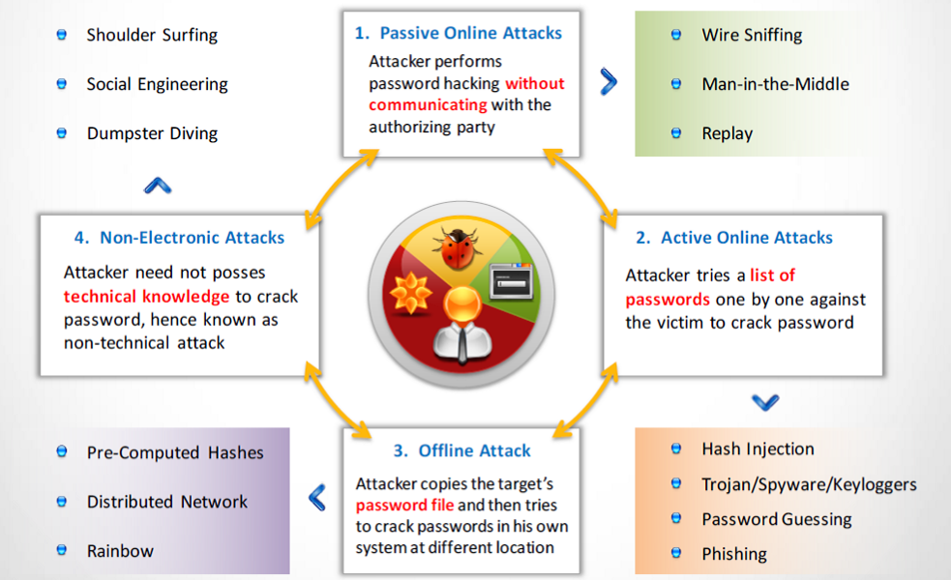
Password Attacks

Slide 35
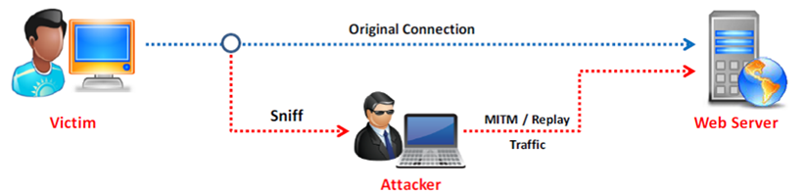
Passive Online Attacks

Slide 36
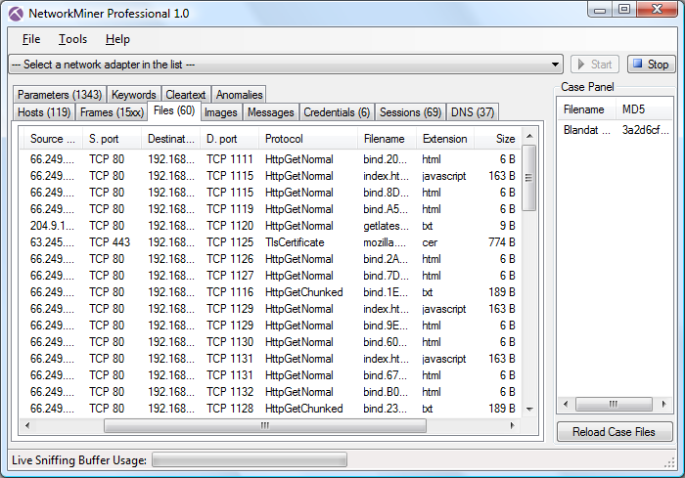
Sniffer
NetworkMiner: can be used as a passive network sniffer/packet capturing tool in order to detect operating systems, sessions, hostnames, open ports, collecting user/pass credentials and etc.
Resources:
https://www.netresec.com

Slide 37
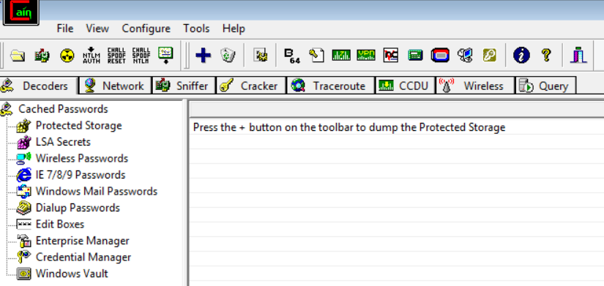
Sniffer
Cain & Abel: is a password recovery tool for Microsoft Operating Systems. It allows easy recovery of various kind of passwords by sniffing the network, cracking encrypted passwords using Dictionary, Brute-Force and Cryptanalysis attacks, recording VoIP conversations and etc.
Resources:
https://www.oxid.it/

Slide 38
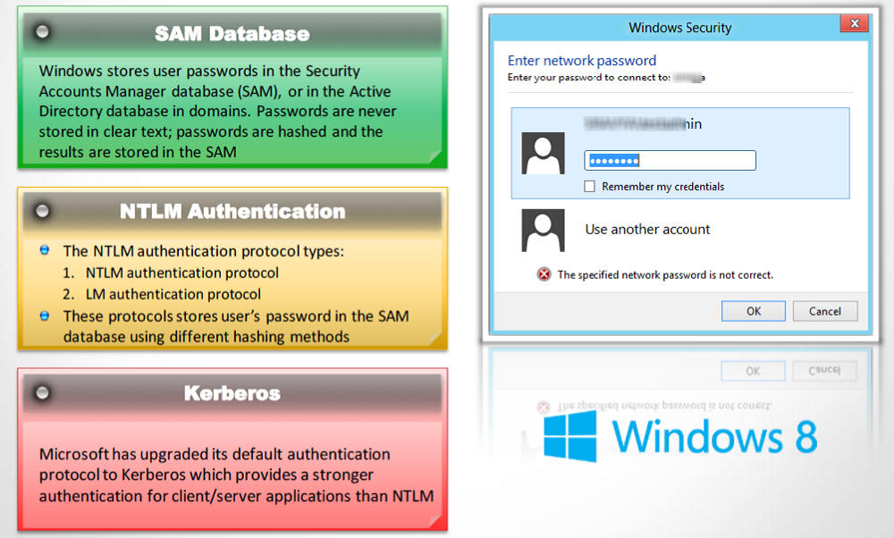
Microsoft Authentication

Slide 39
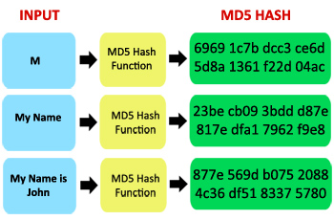
Hashes
It is a one-way mathematical operation performed on plaintext input to create a fixed-length cipher-text output.
Online MD5 Hash Calculators:
http://www.hashkiller.co.uk
https://crackstation.net

Slide 40
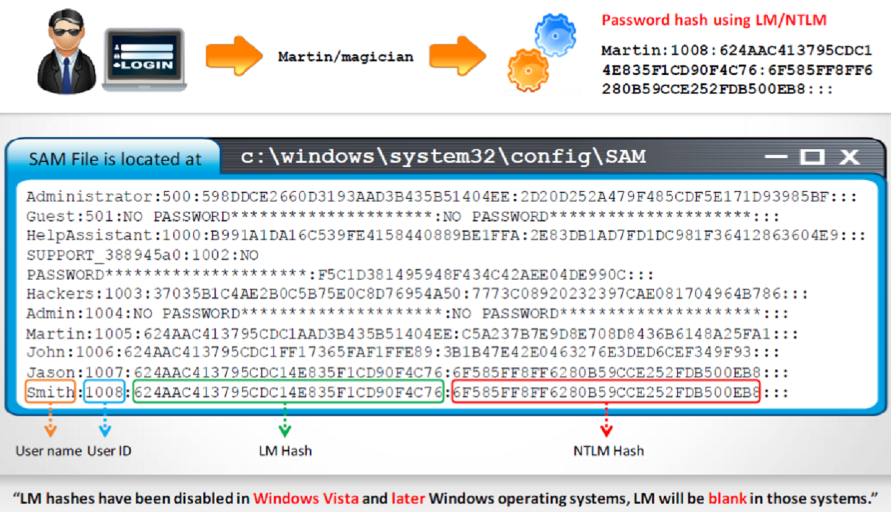
How Hashes are Stored in SAM

Slide 41
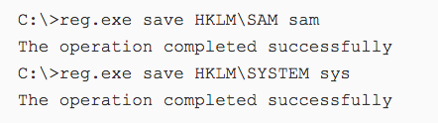
Using reg.exe

Slide 42
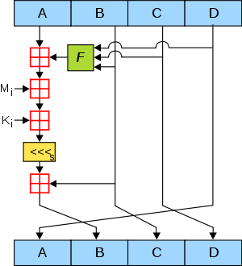
MD5
The MD5 message-digest algorithm is a widely used cryptographic hash function producing a 128-bit (16-byte) hash value, typically expressed in text format as a 32-digit hexadecimal number.
MD5 has been utilized in a wide variety of cryptographic applications and is also commonly used to verify data integrity.

Slide 43
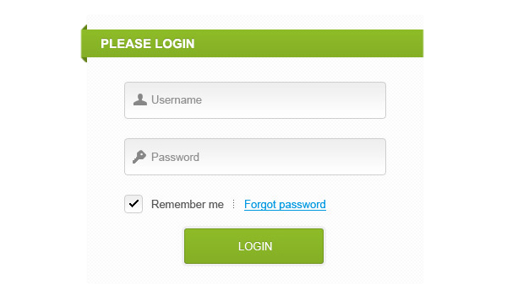
Storing Passwords in Database
$password = md5($_POST[‘password’]);
if(md5($submitted_password) == $stored_password_hash) { login() }

Slide 44
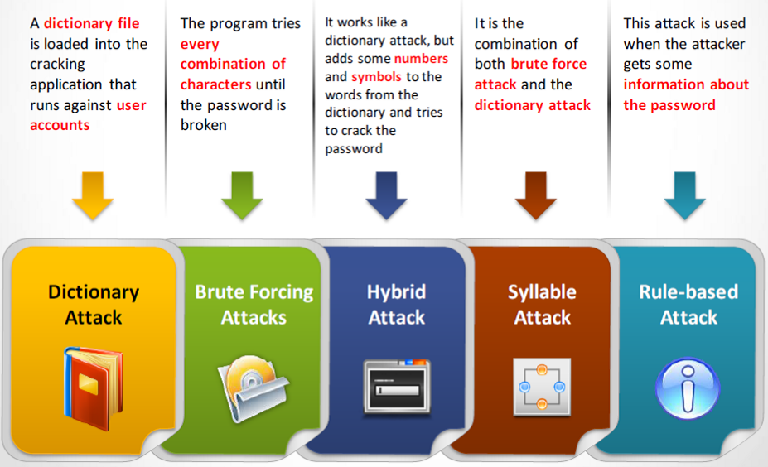
Password Cracking Techniques

Slide 45
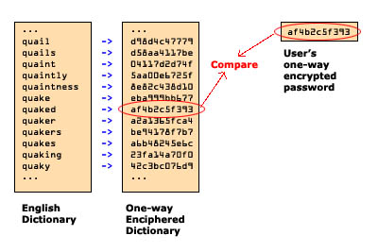
Dictionary Attack
In cryptanalysis and computer security, a dictionary attack is a technique for defeating a cipher or authentication mechanism by trying to determine its decryption key or passphrase by trying hundreds or sometimes millions of likely possibilities, such as words in a dictionary.

Slide 46
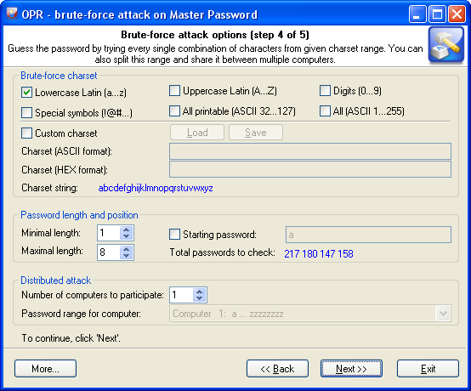
Brute Force Attack
A brute force attack is a trial-and-error method used to obtain information such as a user password or personal identification number (PIN). In a brute force attack, automated software is used to generate a large number of consecutive guesses as to the value of the desired data.

Slide 47
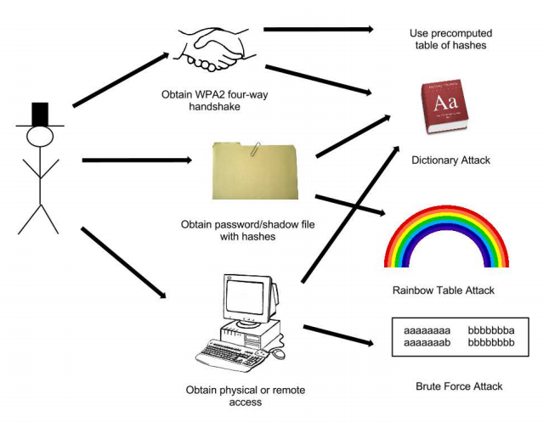
Hybrid Attack
One side is simply a dictionary, the other is the result of a Brute-Forceattack. In other words, the full Brute-Force keyspace is either appended or prepended to each of the words from the dictionary. That's why it's called “hybrid”.

Slide 48
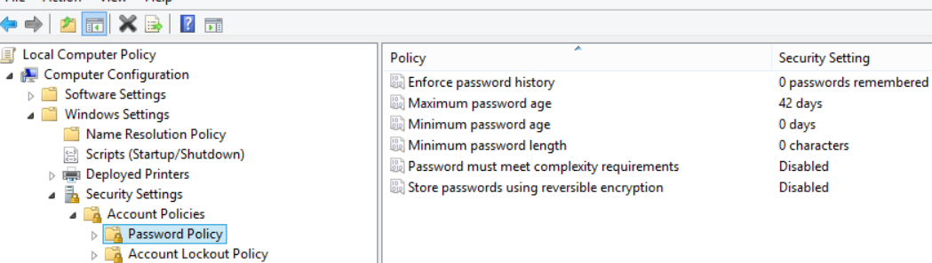
Password Best Practices
Deploy Password Policy and Account Lockout
Minimum length
Complexity
Expiration
Reuse

Slide 49


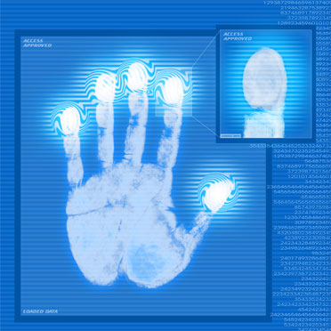
Technology Mitigation
Multi-factor authentication
Smart cards
Biometric

Slide 50
PT and Patching
Try
Try to run penetration testing on all the entry points of your network
Train
Train your staff
Update and patch
Update and patch your OS, software and firmware

Slide 51
Summary
Social Engineering Attacks and Types.
Password Attacks Techniques and Explanation.
Notes:
Chapter 7 summary.

Slide 52
Q & A

Slide 53
Thank You

